Slide 1


The Human Side of Veterinary Care: Creating Space for Reflection and Connection
September 30, 2026
Schwartz Compassion in Action Webinar

Slide 2







The Schwartz Compassion in Action Webinar Series is brought to you by:
Ellen Feldberg Gordon and Michael Gordon,
in memory of Julian and Eunice Cohen

Slide 3
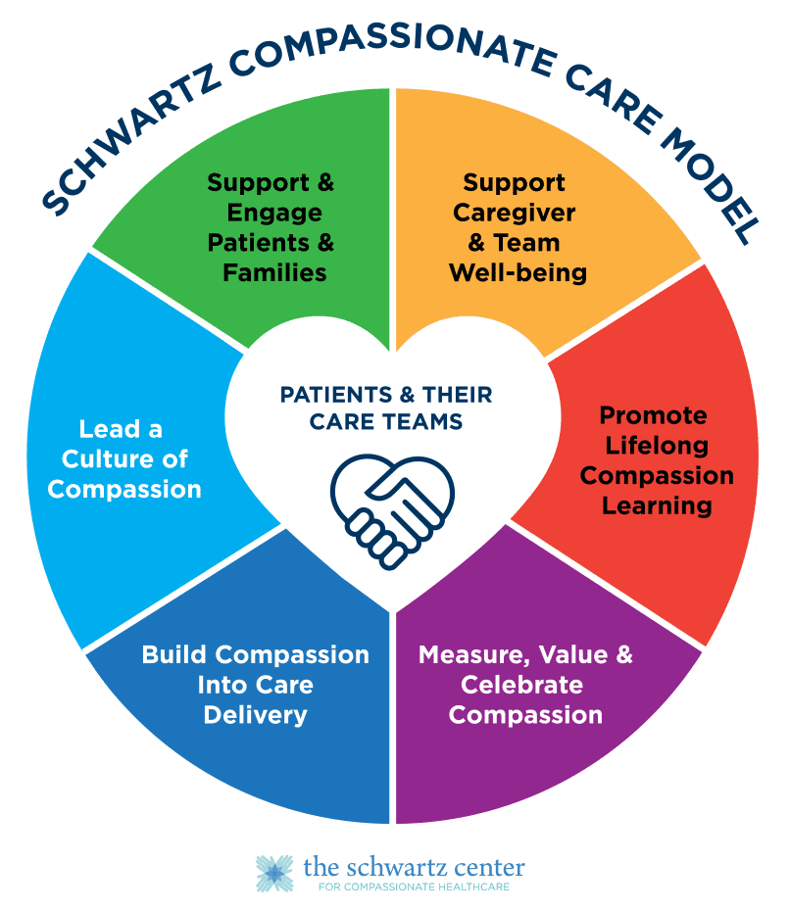
A Roadmap for Advancing Organization-wide Compassion
Learn more at:
theschwartzcenter.org/care-model

Slide 4
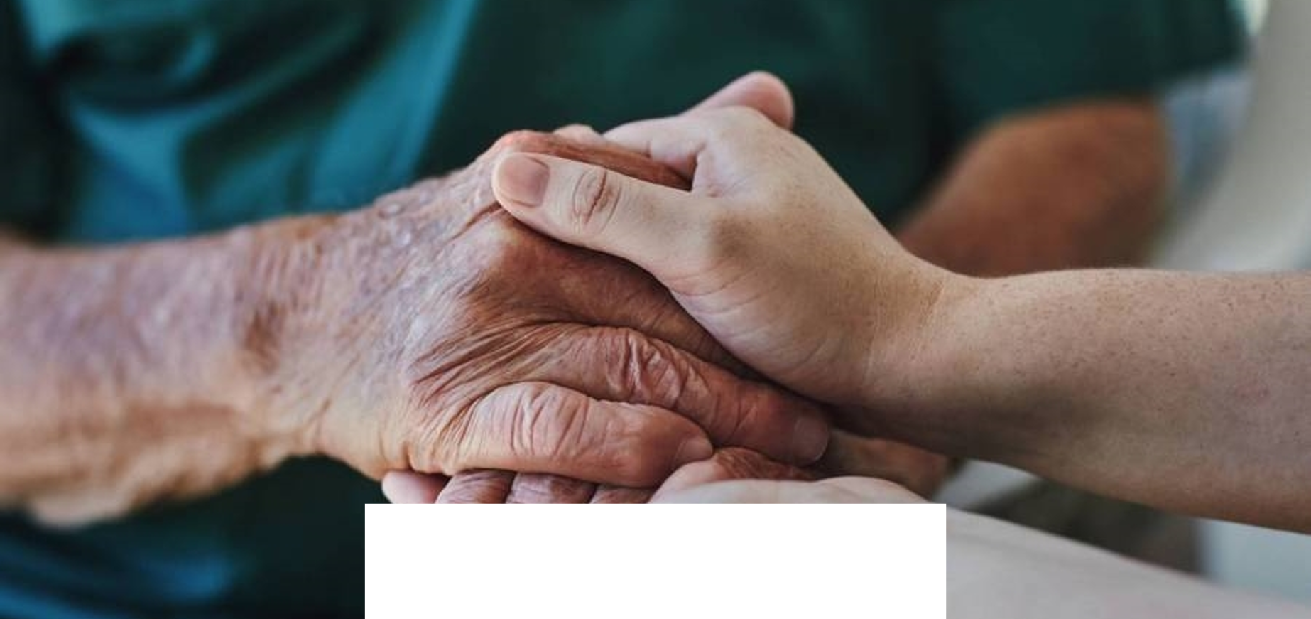

The Human Side of
Veterinary Care
Amy Martin RVN
30th September 2026

Slide 5
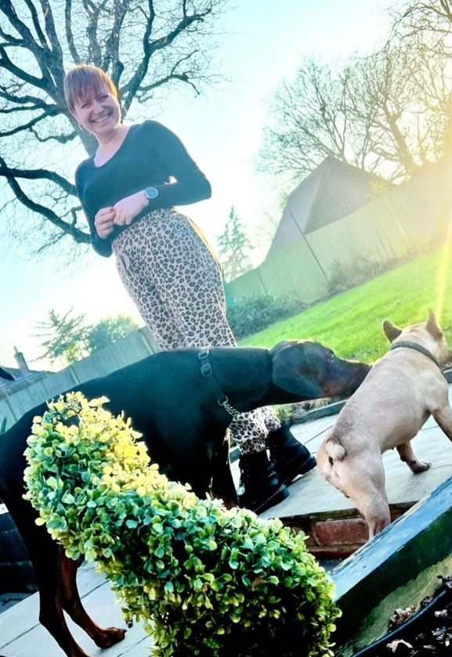
Amy Martin MA BSc(Hons)RVN
Trained as an RVN, I have been in veterinary practice leadership for 20 years. I am a qualified coach and organisation development practitioner and I teach leadership. As a leader I felt that happy teams practised great veterinary medicine and sought to improve the lives of those I worked with.
“Happy teams practise great veterinary medicine”
02

Slide 6
Why do we need compassion in veterinary care?
Compassionate veterinary care enables contextualised care.
This serves better patient outcomes and pet owner satisfaction.
Compassion also supports the caregivers in their role.
Animal welfare
Pet owner satisfaction
Veterinary professionals

Slide 7
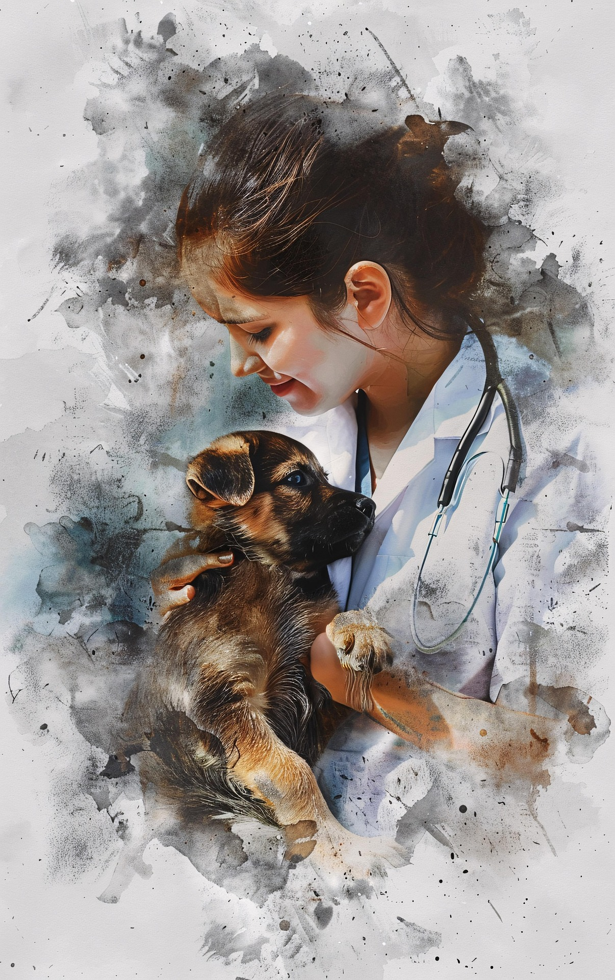
What are the prevailing issues in veterinary care?
01
02
High workloads
Lone working
High volumes of work sometimes without the personnel to accomplish the work to a high standard. Unexpected workloads.
Sometimes isolated or lone working and working at night.
03
04
Emotional Labour
Public expectation
Highly emotive, high stakes work. Task switching between types of veterinary medicine.
Perceived pressure for favourable outcomes. Financial burden of paying at the point of service.
Image by Tylijura from Pixabay

Slide 8
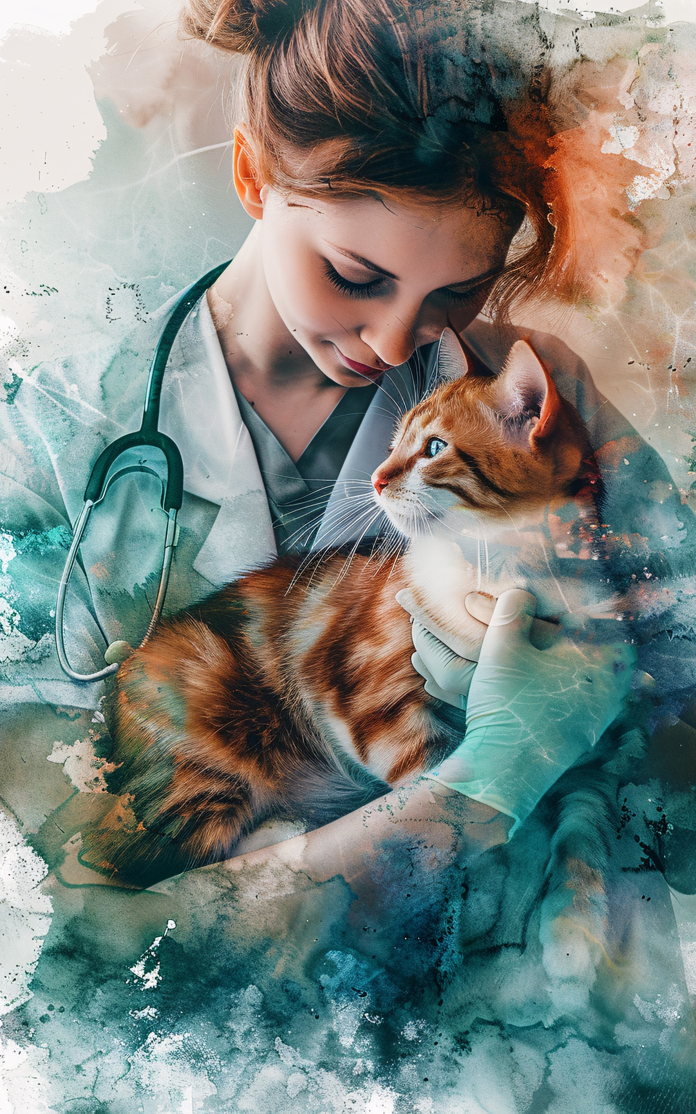
Why do we need compassion practise in veterinary care?
01
02
Self-Care
Perfectionism
Many veterinary professionals put their own needs behind their patients and clients
Many veterinary professionals struggle with good enough
03
04
Hidden curriculum
Burnout and Compassion Fatigue
Many veterinary professionals have a feeling that they should be able to manage. Asking for help can be perceived as weakness.
Many times, the job can take more than it gives from veterinary professionals
Image by Tylijura from Pixabay

Slide 9
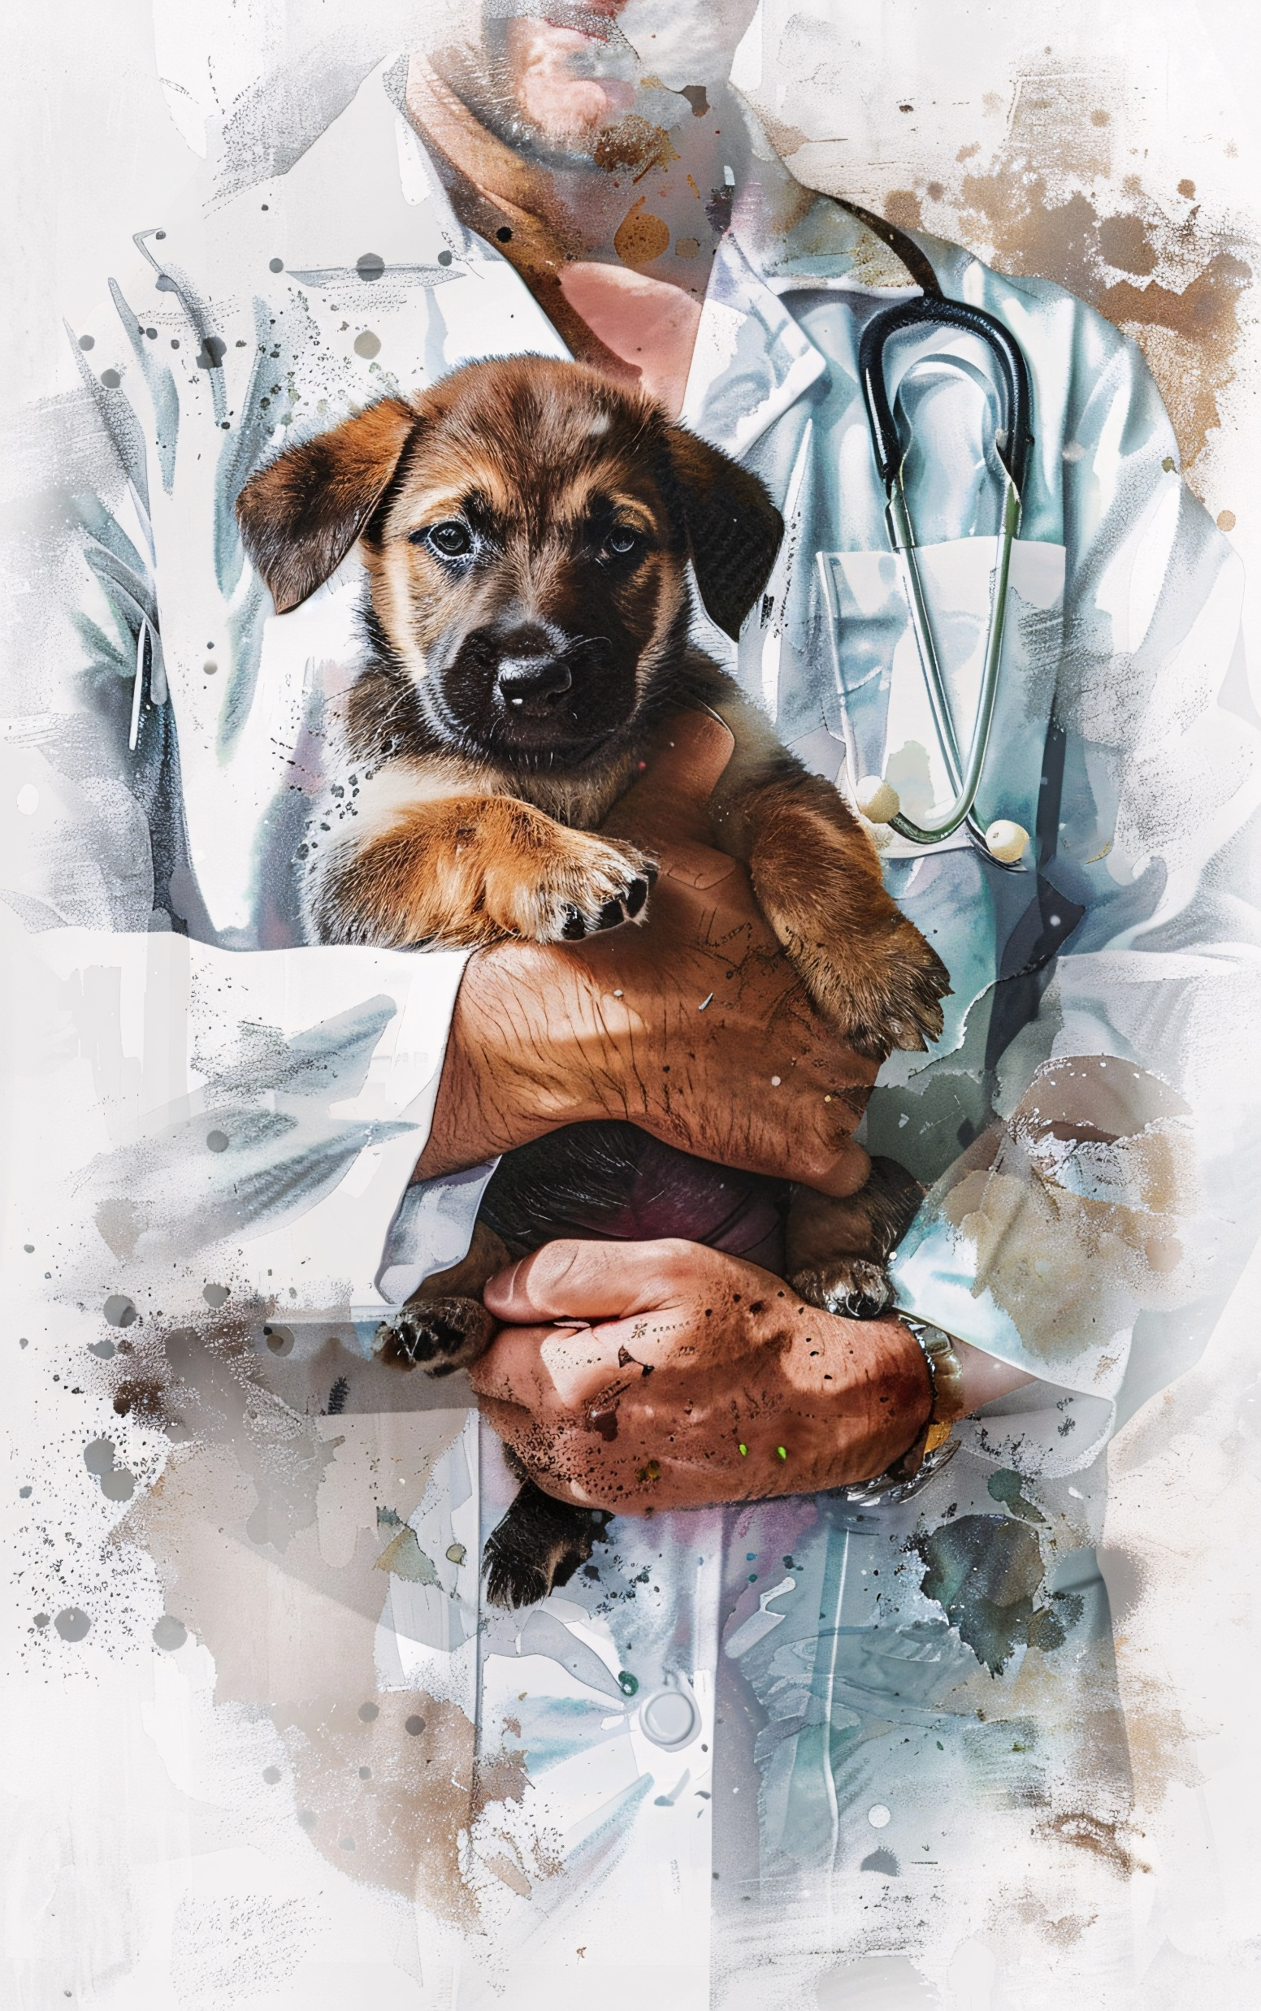
Compassion types
01
02
Self to self
Others to self
The ability to be compassionate to oneself.
The ability to ask for and accept help from others.
03
Self to others
The ability to offer and give help to others.
Image by Tylijura from Pixabay

Slide 10
Compassion and empathy
Compassion
Empathic Concern
Sympathy
[Cognitive empathy]
Other related emotion
Positive feelings
Good Health
Prosocial motivation
Empathy
Empathic Distress
[Affective empathy]
Self related emotion
Negative feelings and stress
Poor Health
Burnout
Withdrawal
- Singer & Klimecki (2014)
05

Slide 11
Compassion
Veterinary professionals are often not taught the nuance and boundary management needed for emotional labour.
“When we label our emotions accurately, we are more able to discern the precise cause of our feelings”
Sympathy - Distant
- Susan David
I’m sorry you are in pain
Empathy - Shared
I can practice perspective taking by imagining what this pain might feel like
Compassion – Connected and action orientated
You are suffering and I will do what I can to help

Slide 12
“
Boundaries are the distance at which I can love you and me simultaneously
- Prentis Hemphill

Slide 13
“
We propose that people’s limited-compassion mindsets—beliefs about compassion as a limited resource and a fatiguing experience—can result in a self-fulfilling prophecy that reinforces compassion fatigue. Across four studies of adults sampled from university students and online participant pools in the United States, we show that there is variability in people’s compassion mindsets, that these mindsets can be changed with convincing information, and that limited-compassion mindsets predict lower feelings of compassion, lower-quality social support, and more fatigue.
- Gainsburg & Cunningham (2023)

Slide 14
Interventions
Making a tangible difference to the wellbeing of veterinary teams requires a multi pronged approach
Individual
Compassion practice - loving kindness meditation
Individual counselling
Group
Supported individual or group reflective practice/clinical supervision
Organisational intervention
Schwartz Rounds

Slide 15
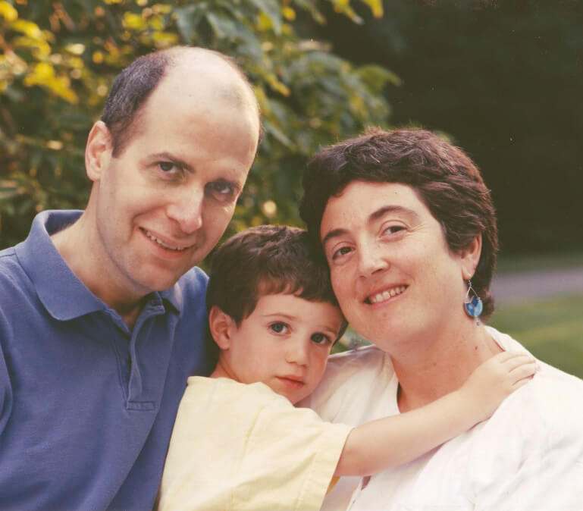

Where is the concept from?
“I have learned that medicine is not merely about performing tests or surgeries, or administering drugs... For as skilled and knowledgeable as my caregivers are, what matters most is that they have empathized with me in a way that matters, gives me hope and makes me feel like a human being.”
Ken Schwartz, US Healthcare Lawyer
10

Slide 16
Format of a Schwartz Rounds Session
“
Schwartz Rounds sessions are not to problem solve or think about what we could have done differently, only to reflect on the emotional and social aspect of the work we do
01
02
03
04
05
Facilitator intro & history of SR
Storytellers speak uninterrupted
Discussion opened to the room
Facilitators close the session
Storytellers invited to say last words
Facilitators frame the session and set ground rules such as time keeping and confidentiality
Focus is not on clinical details but the emotional and social aspect of the work
Participants reflect on resonance of the story and their own experiences
No problem solving
Wrap up of themes and thanks to the storytellers and participants
Often reflect on the experience of telling their story
05

Slide 17
What Schwartz Rounds sessions are, and are not…
Schwartz Rounds sessions are an organisational intervention.
Traditional Staff Forums | Schwartz Rounds
Grand Rounds... aim to help medical staff learn about recent developments in medicine and focus on the clinical details of a case. | Schwartz Rounds... do not focus on the clinical aspects of patience care; instead, learning is focused on understanding staff experience from a social and emotional viewpoint.
Supervision... involves expertise and advice; is generally aimed at a specific staff group; focuses on technical aspects of care, clinical outcomes or personal development unlike Schwartz Rounds sessions. | Schwartz Rounds... are not designed as a form of peer supervision and do not fit the traditional model of clinical supervision.
Debrief... usually structured meetings that aim to help staff following stressful or traumatic clinical events, through education, normalising and support | Schwartz Rounds... should not be used as a form of debriefing. If there is a case that has been particularly troubling for staff and the organisation, a certain amount of time will need to pass before it is addressed in a session.
13

Slide 18
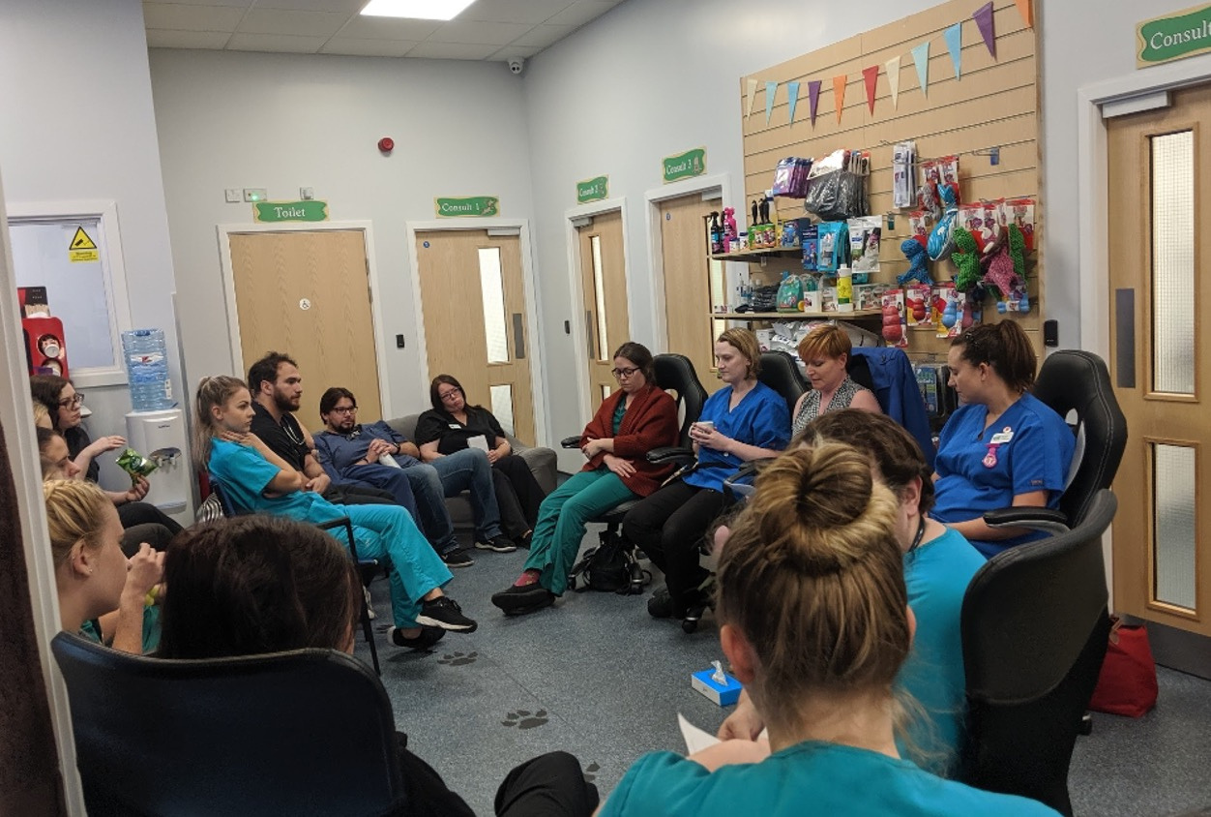
What’s the evidence?
Two key studies (Lown & Manning, 2010, and Goodrich, 2011) have shown that staff who regularly attended Schwartz Rounds reported:
  Decreased feelings of stress and isolation
  Feeling valued
  Improved team-work, connectedness and communication
  Greater appreciation for other disciplines / roles
  More openness to giving and receiving support
  Diminished hierarchies between senior and junior staff
  Increased feelings of compassion towards patients (humans)
  Increased attentiveness to social and emotional aspects of care

Slide 19
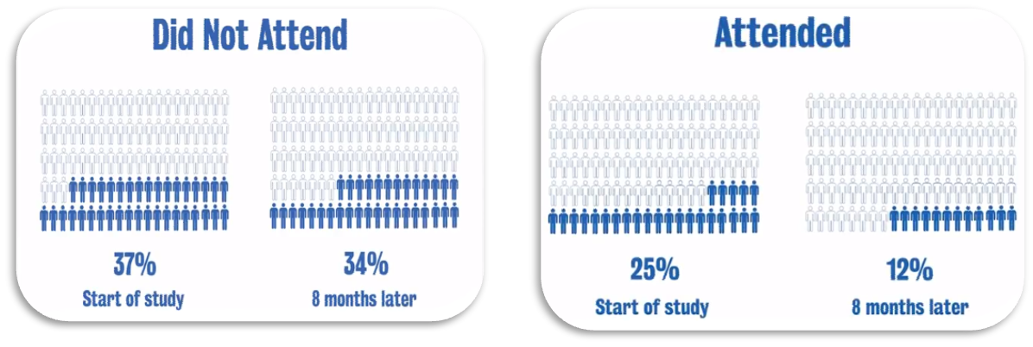
Further Qualitative Evidence
The Longitudinal National Evaluation of Schwartz Rounds (Maben et al, 2018)
  The wellbeing of staff who attended Schwartz Rounds sessions regularly significantly improved, with the proportion of those with psychological distress halving - down from 25% to 12%
  There was little change in the psychological wellbeing of staff who did not attend Schwartz Rounds session over this 8-month period.

Slide 20
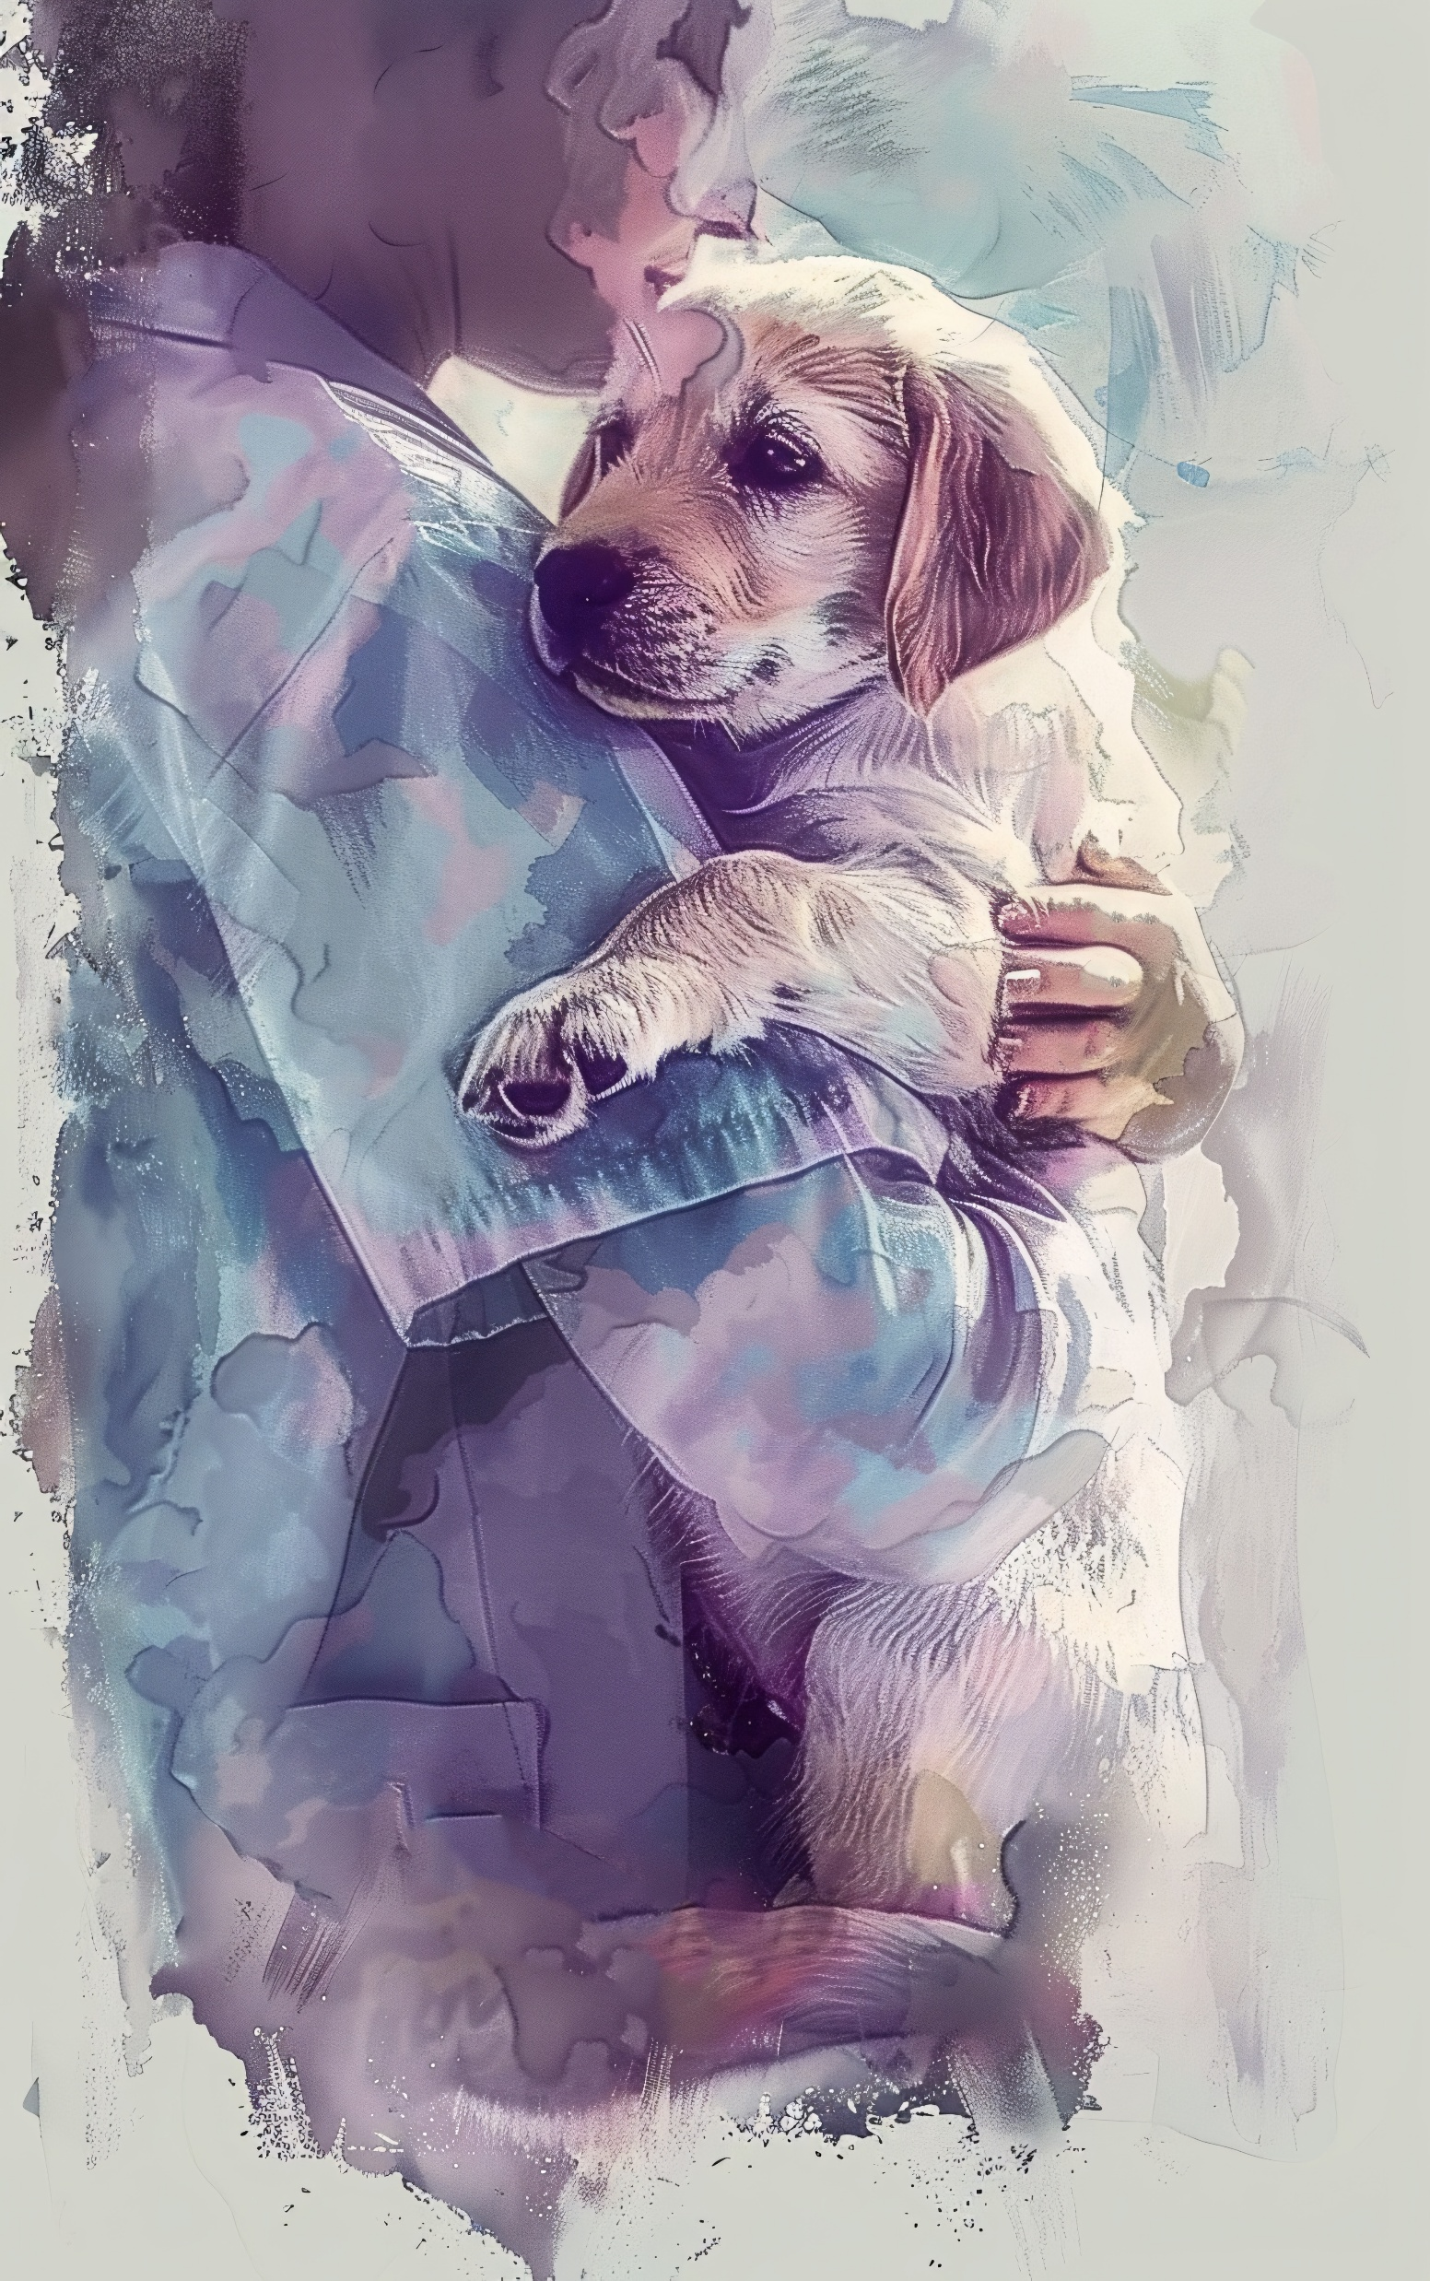
Why might the Schwartz Rounds program help?
01
02
Normalising Emotions
Promoting Connectedness & Increasing Insight
Sharing emotions allows staff to move from a place of isolation to shared understanding, reducing the sense of difference
Schwartz Rounds sessions appear to engender a sense of connectedness with the ‘whole’ system
03
04
Creating a Culture of Openness & Changing Narratives
Flattening Hierarchy
More senior team members are seen as human by others
A consistent reflective space may impact on the organisation more broadly, encouraging staff to employ their reflective stance in their work outside the Round.
Shift from feelings of shame, guilt, disgust to being more self-compassionate and forgiving
Image by Tylijura from Pixabay

Slide 21
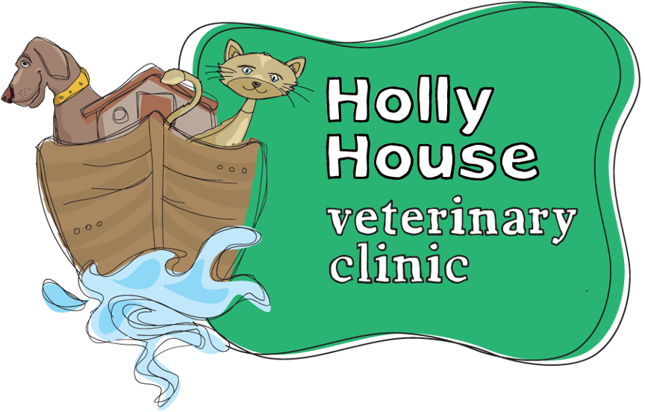
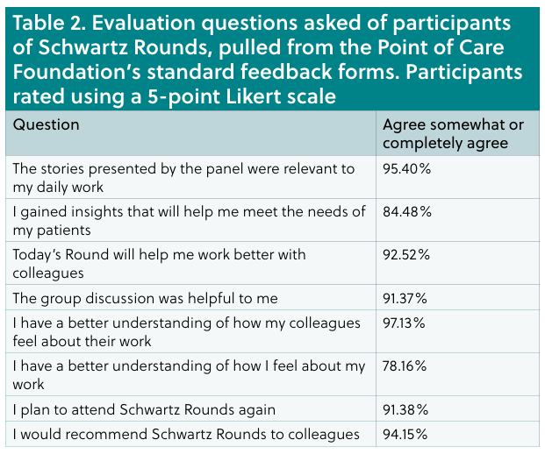

Evidence in Veterinary Practice
Retrospective review of a Schwartz Rounds service for a veterinary team (Martin, 2024)
Possible Organisational Benefits
  Lower absenteeism
  Lower staff turnover rates
  Client satisfaction
  Lower complaints

Slide 22
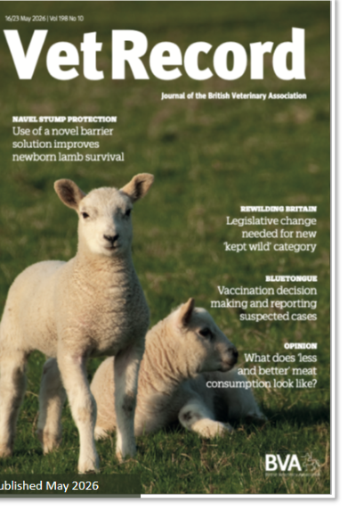
Qualitative Research
Good support for vet Schwartz Rounds program in evaluation surveys
Lack of qualitative insight from these surveys . . .
Research Objectives;
In what ways does attendance at Schwartz Rounds sessions impact the experience of veterinary professionals working in clinical practice?
Are the proven benefits of the Schwartz Rounds program in human healthcare translatable to those working in the veterinary profession?
Published May 2026
17

Slide 23
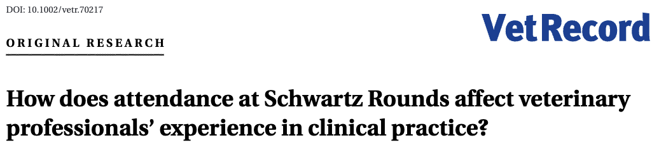
Campbell & Ormandy 2026
1
2
3
Enable Compassion
Empower Vulnerability
Enhance Organisational Insight
• Hearing others’ stories allowed;
› Self-compassion
› Colleague compassion
› Client compassion
• Schwartz skills used to improve listening to those in emotional distress
• Ripple effect seen outside of the Schwartz space
• Schwartz Rounds create a psychologically safe space for professional masks to lift*
• When leaders showcase vulnerability, this helps humanize them to peers
• Management showcasing emotions helped open the door for team members to seek help
• Schwartz Rounds sessions will always be voluntary; non-attendees need support too
• Meaningful colleague connection took place that otherwise would not
• Discussions improved understanding between roles (clinical/non-clinical)

Slide 24
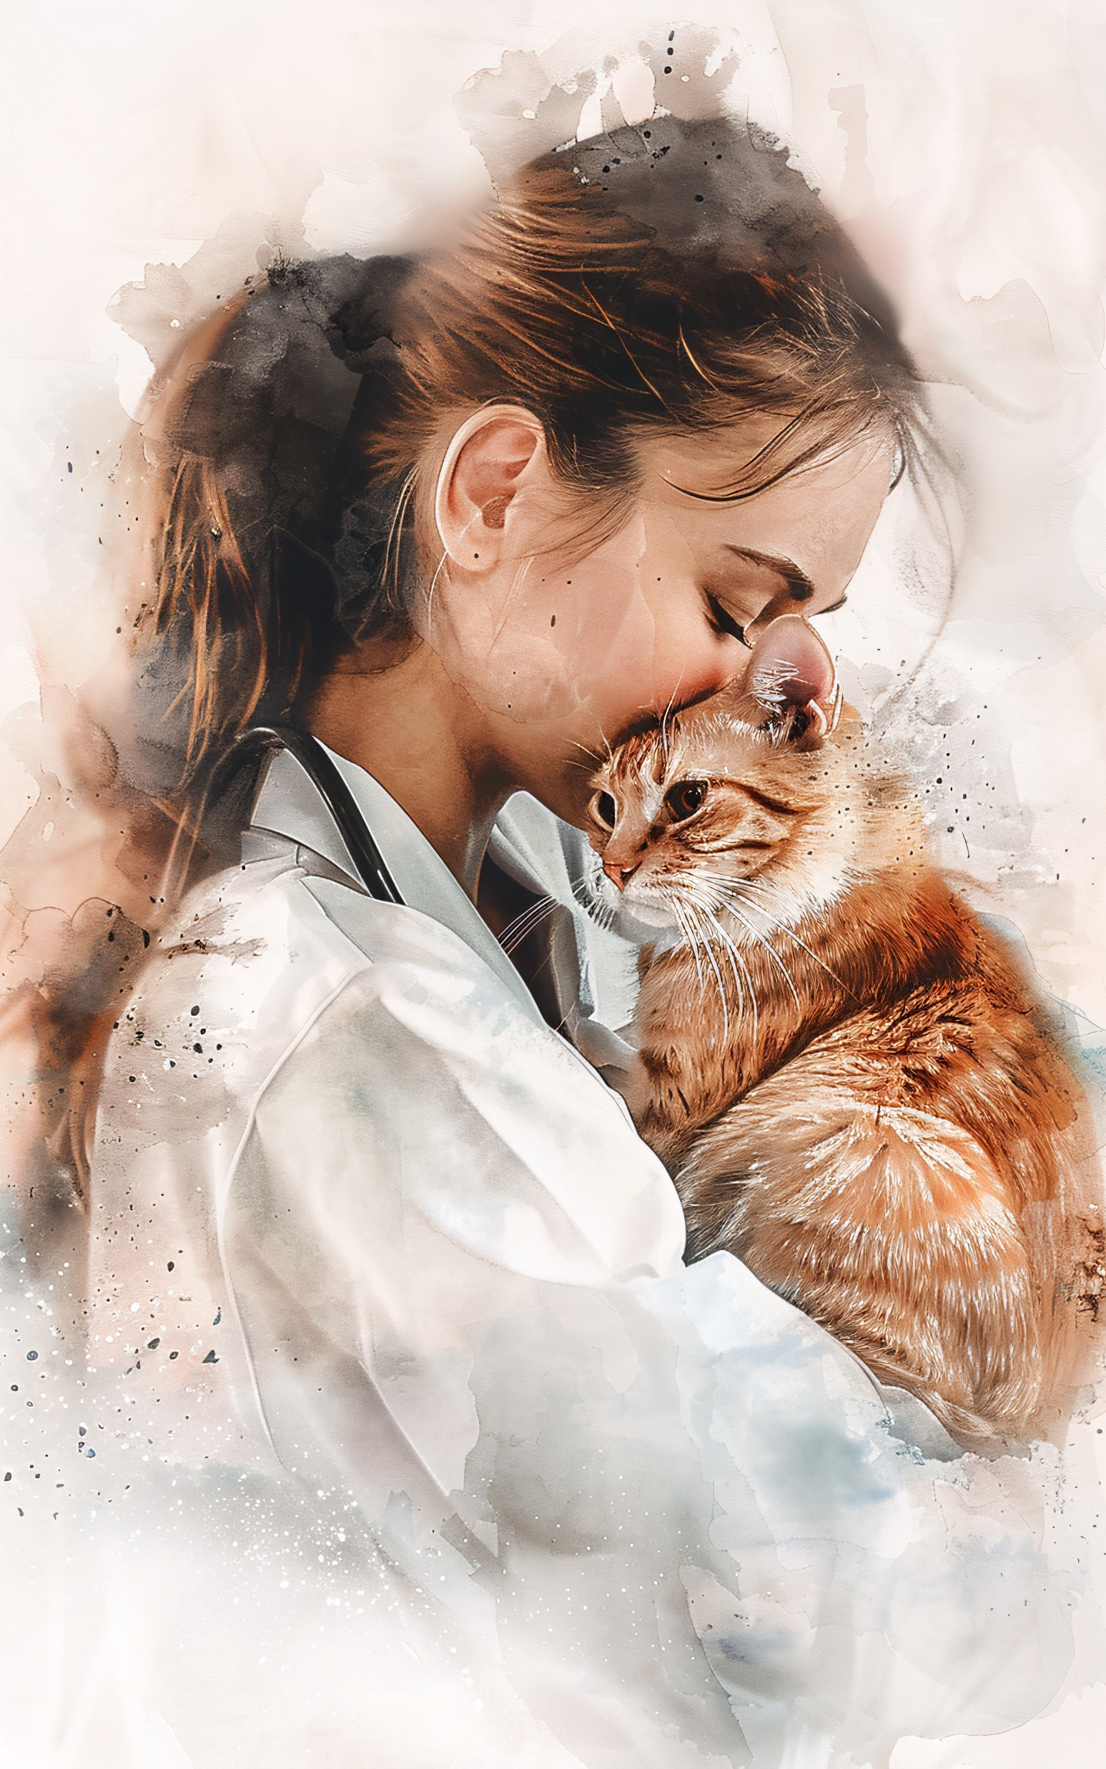
Learnings from implementation
01
02
Time
Organisational support
Planning and Implementation
Senior Leadership Team buy in
03
04
Leadership modelling
Consistency
Leaders attending for role modelling and organisational insight purposes
This is a key driver of success
Image by Tylijura from Pixabay

Slide 25
One health lens and compassion in the pet owner relationship
Veterinary professional can play an important social care role alongside medical professionals
Veterinary professionals occupy a unique and trusted healthcare position where the difference they can make to society at large is immense.
In order to do this veterinary professionals should be supported in compassionate caregiving.
Noticing and supporting vulnerable adults
Dementia care, safeguarding concerns
Non-accidental injury
Linking to social work support & reporting
Loneliness
Another point of contact for individuals that are pet owners

Slide 26

What’s the difference you can make to someone through compassionate care?
And what support do you need to achieve that?
hello@magnoliacoaching.co.uk

Slide 27


Thank you for joining us.
Learn more: theschwartzcenter.org
Email us: community@theschwartzcenter.org

